Slide 1
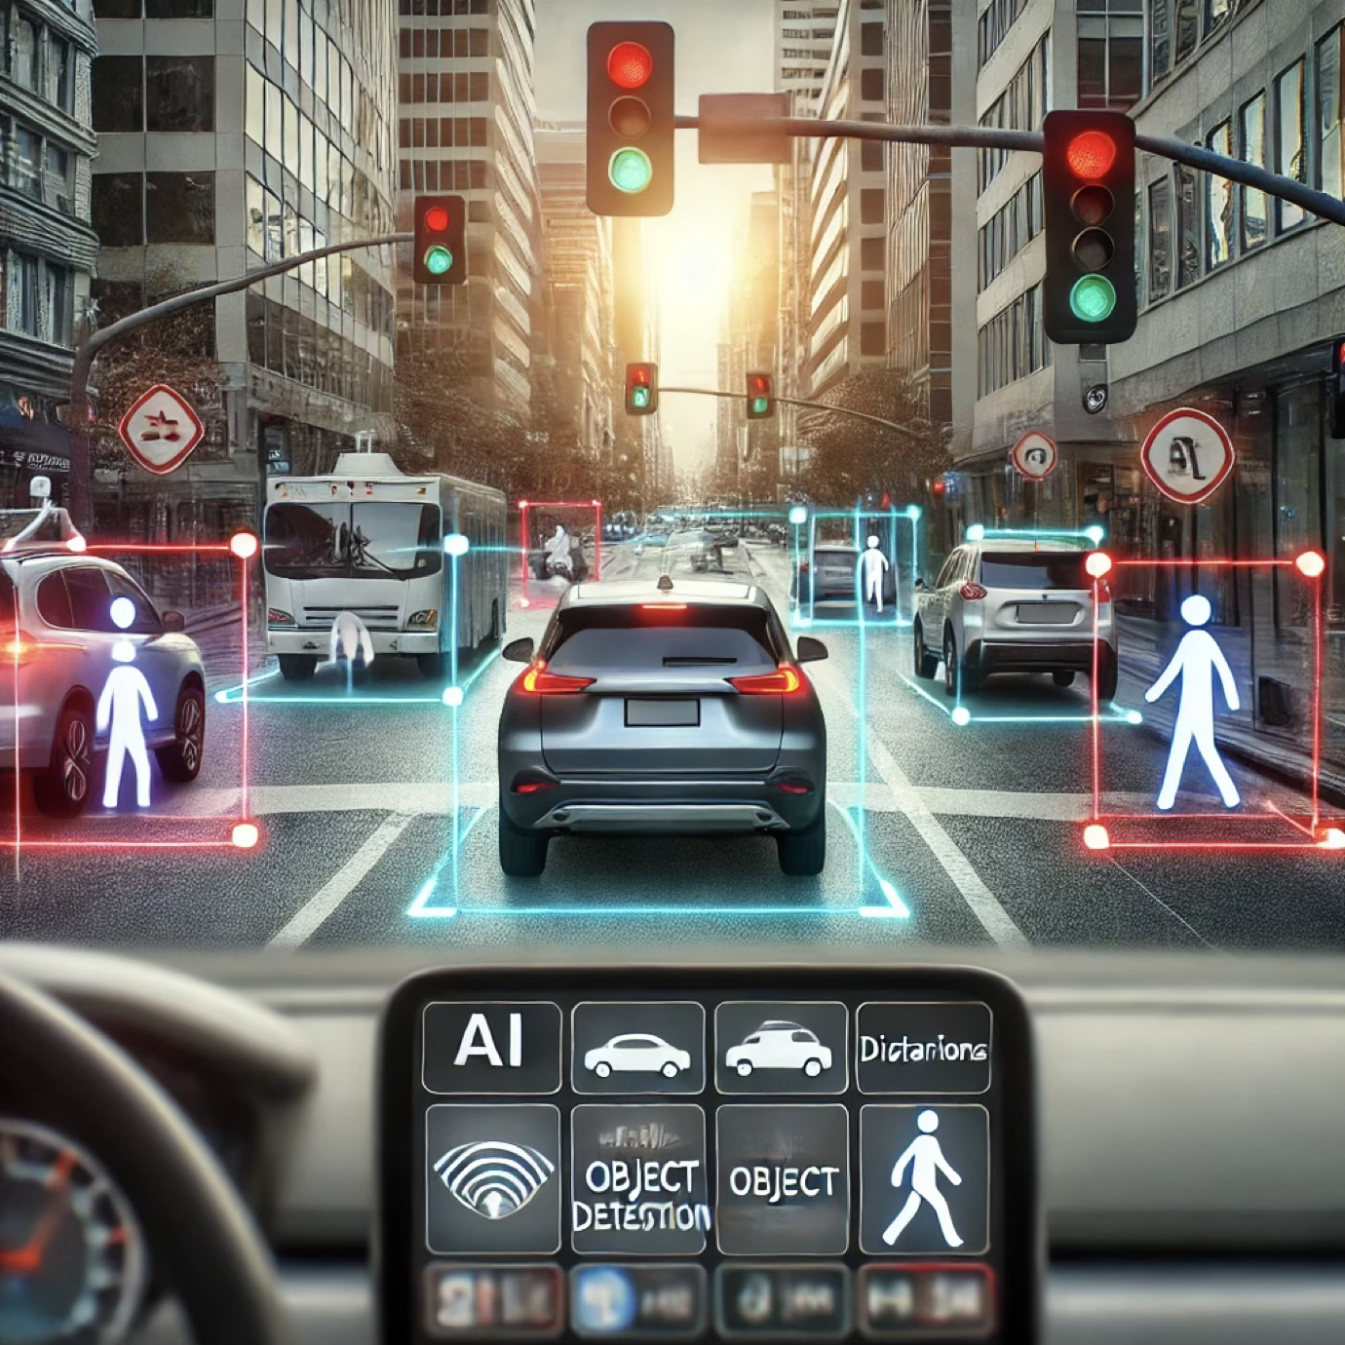

Machine Learning Workflows for Images
Dr. David Raj M
Assistant Professor & Assistant Director, RAAC
School of Advanced Sciences
Vellore Institute of Technology, Chennai

Slide 2
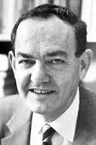
What is Machine Learning?
“Learning is any process by which a system improves performance from experience.”
- Herbert Simon

Slide 3

What is Machine Learning?
Definition by Tom Mitchell (1998):
Machine Learning is the study of algorithms that
improve their performance P
at some task T
with experience E.
A well-defined learning task is given by <P, T, E>.

Slide 4
Traditional Programming
Data Program
Computer
Output
MACHINE LEARNING
Data Output
Computer
Program

Slide 5
When Do We Use Machine Learning?
Automate tasks, analyze data, and improve decision-making
Human expertise does not exist (navigating on Mars)
Humans can’t explain their expertise (speech recognition)

Slide 6
Humans can’t explain their expertise (speech recognition)

Slide 7
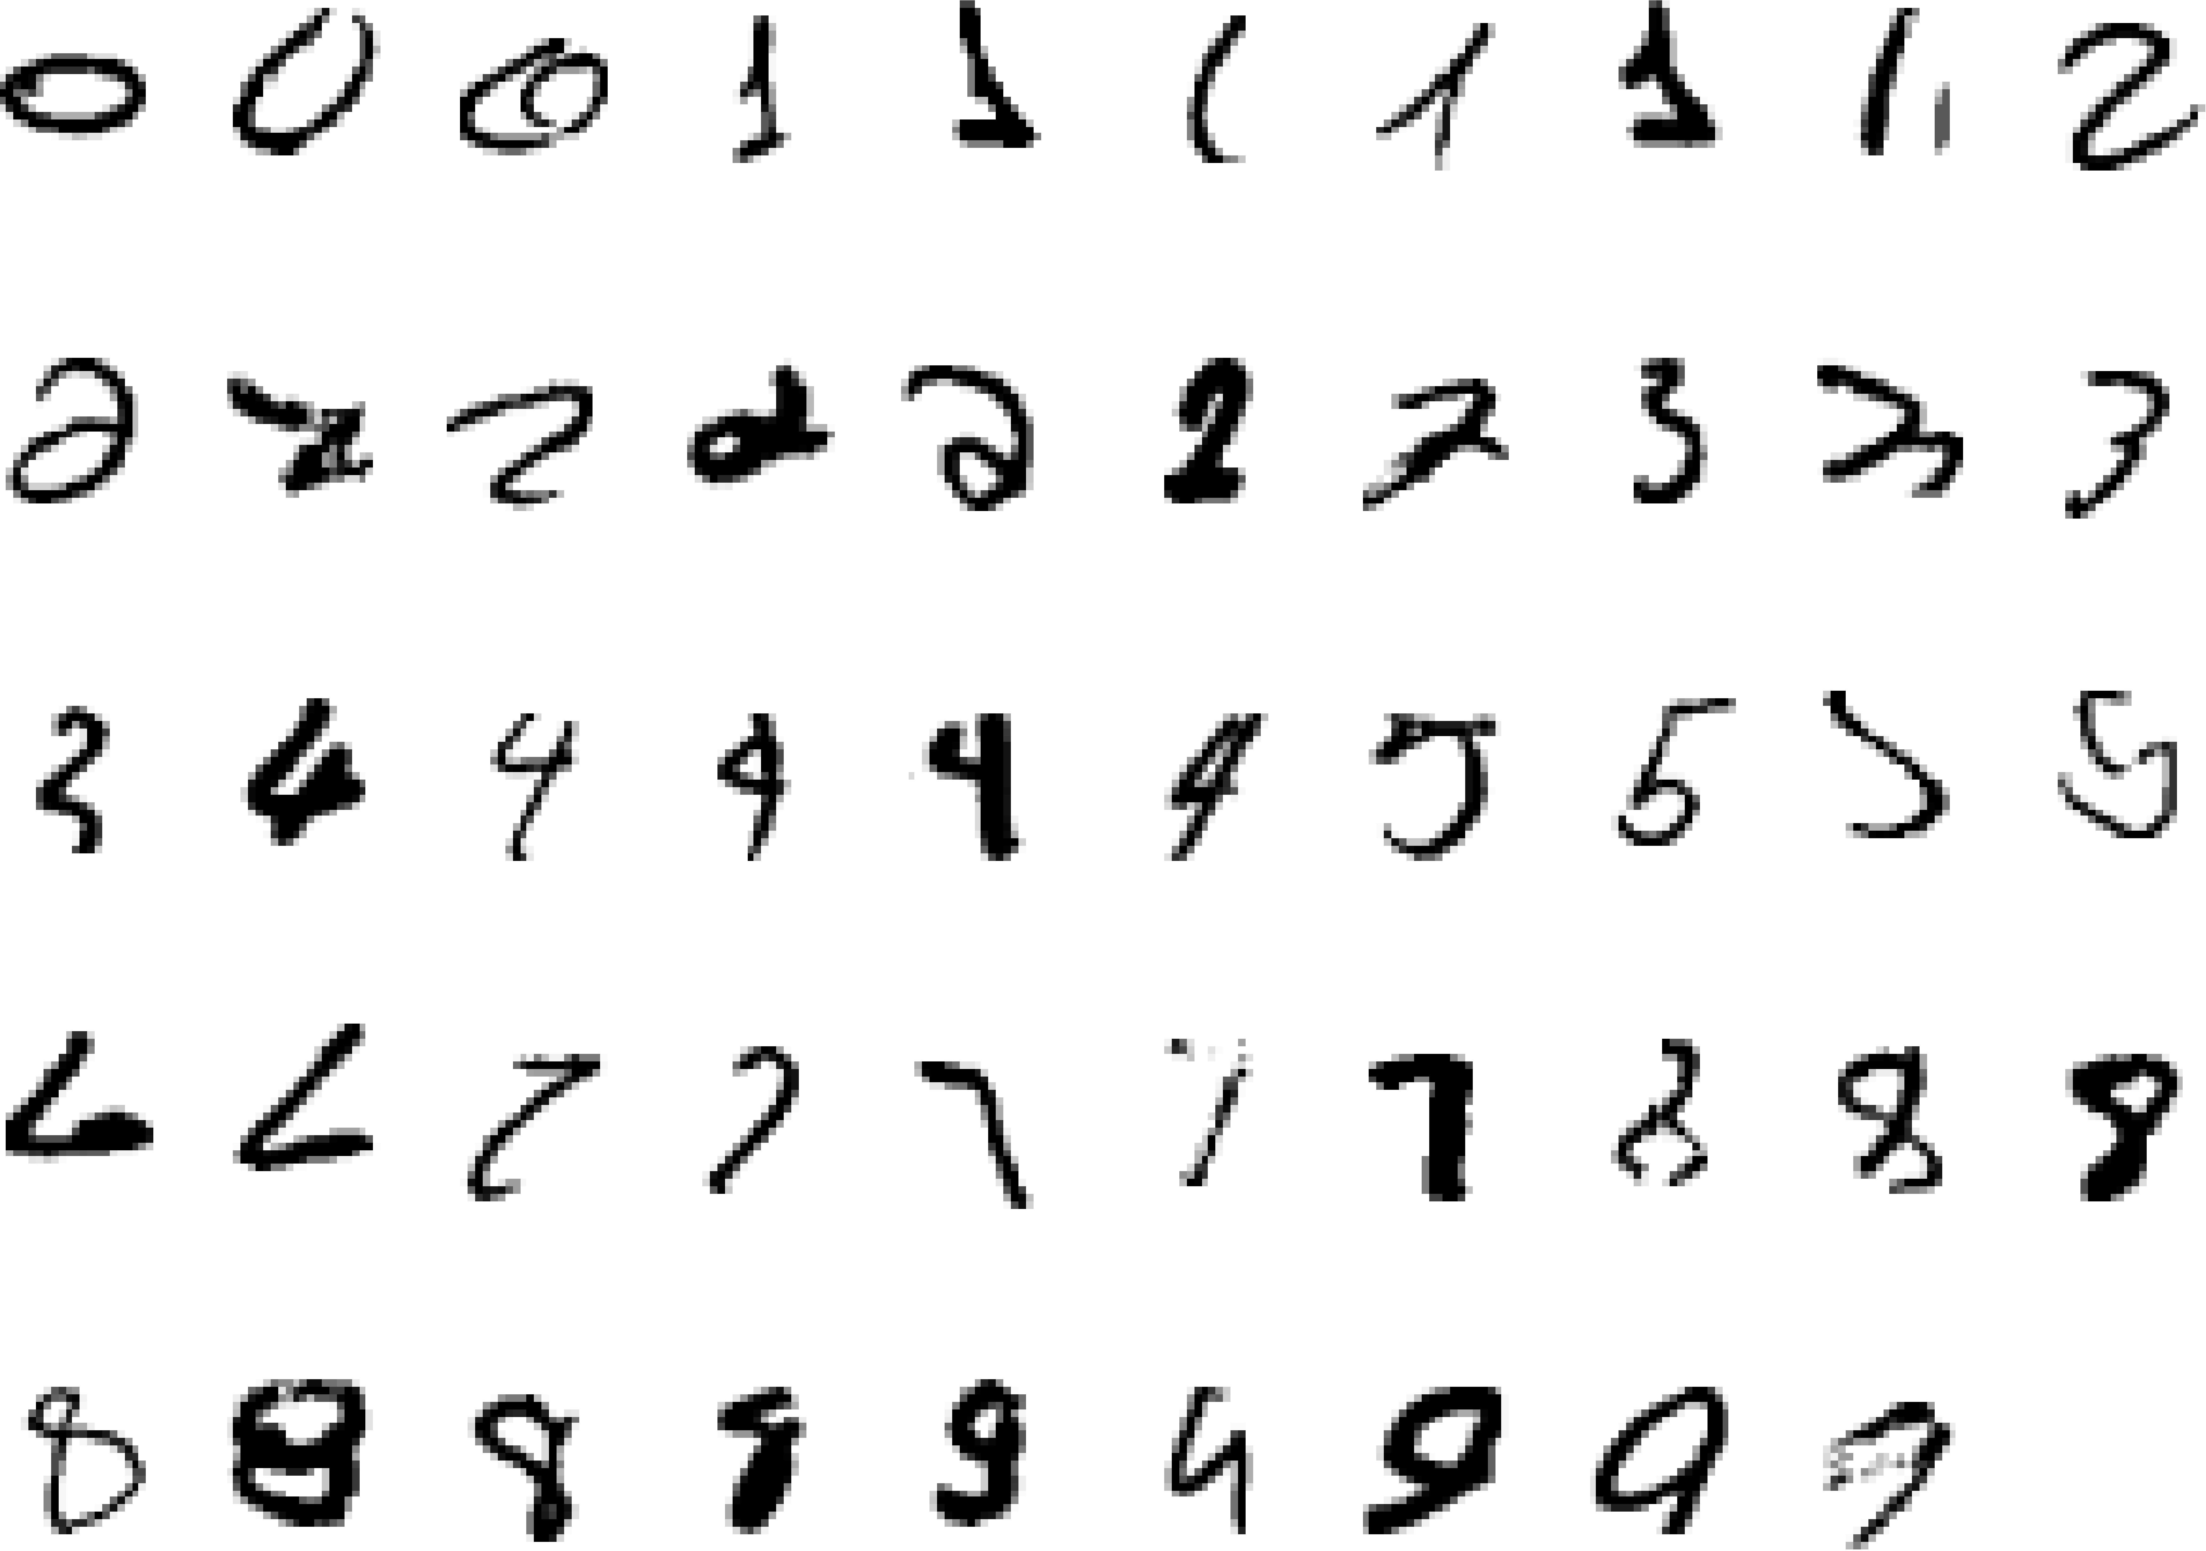
A Classic Example
Can you say which one of the these is the number 2?
It Is Very Hard To Say What Makes a 2.

Slide 8
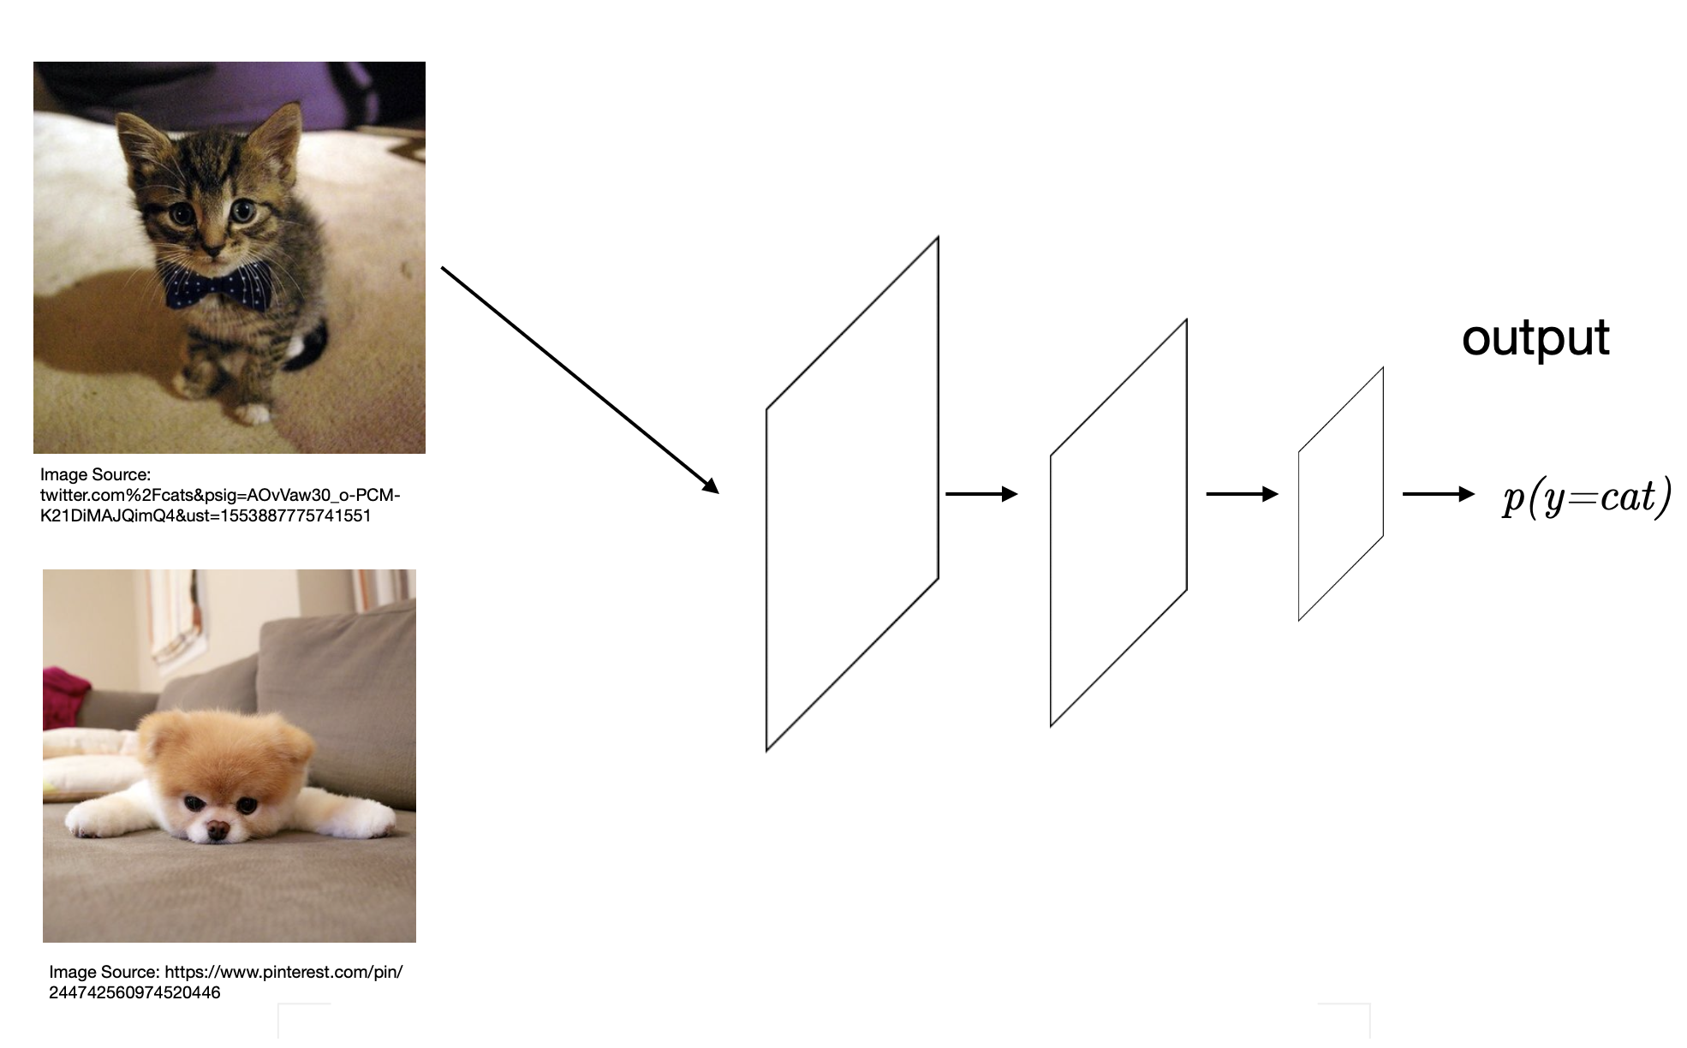

Slide 9
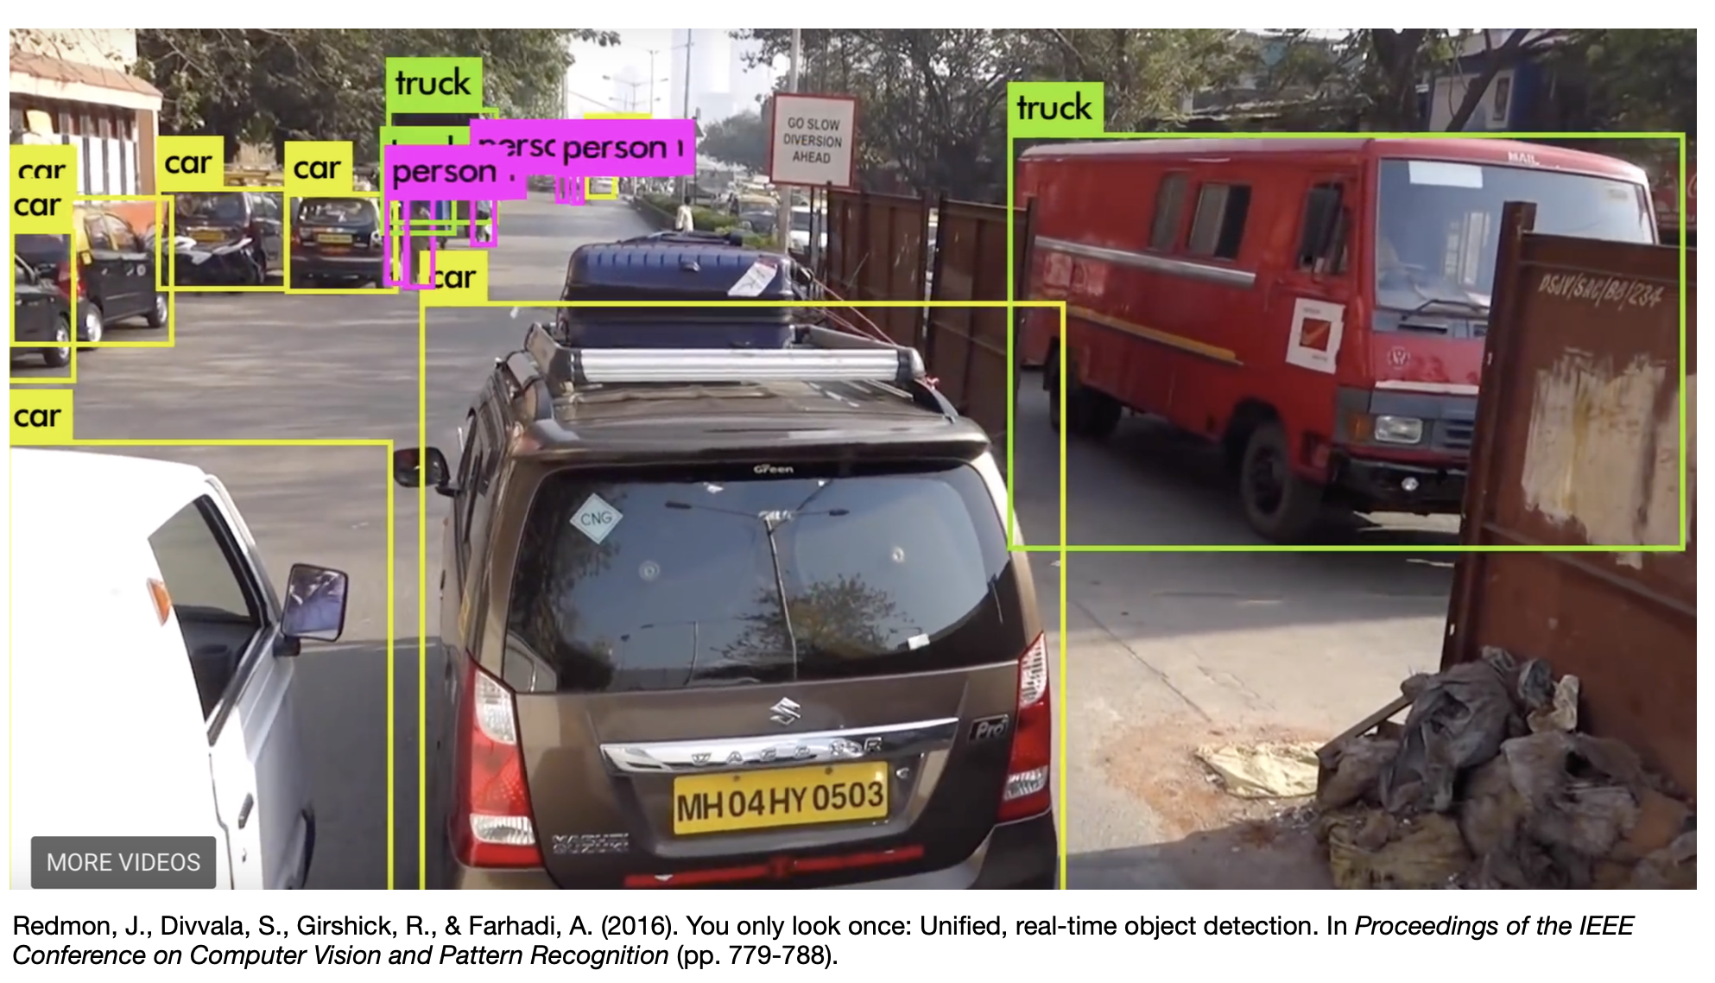

Slide 10
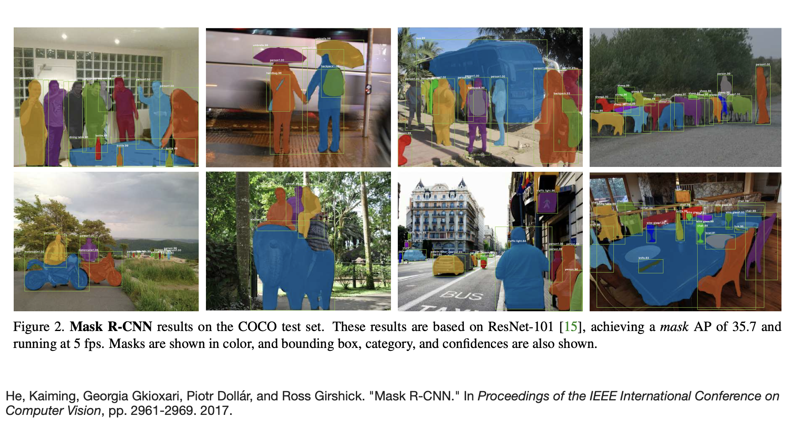

Slide 11
Some More Examples
That Are Best Solved By Using a Learning Algorithm
Recognizing patterns:
Facial identities or facial expressions
Handwritten or spoken words
Medical images
Generating patterns:
Generating images or motion sequences
Recognizing anomalies:
Unusual credit card transactions
Unusual patterns of sensor readings in a nuclear power plant
Prediction:
Future stock prices or currency exchange rates

Slide 12
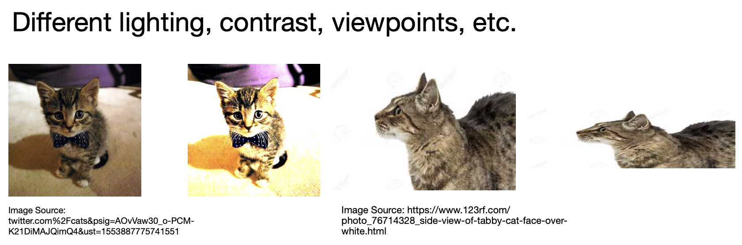
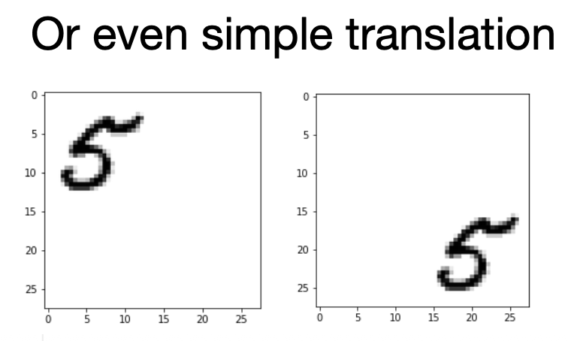
Why Image Classification is Hard

Slide 13
ML in a Nutshell
Tens of Thousands of Machine Learning Algorithms
Hundreds New Every Year
Every Machine Learning Algorithm Has Three Components:
Representation
Evaluation
Optimization

Slide 14
Representation
Decision trees
Sets of rules / Logic programs
Instances
Graphical models (Bayes/Markov nets)
Neural networks
Support vector machines
Model ensembles, etc.

Slide 15
Evaluation
Accuracy
Precision and recall
Squared error
Likelihood
Posterior probability
Cost / Utility
Margin
Entropy
K-L divergence, etc.,

Slide 16
Optimization
Combinatorial optimization
E.g.: Greedy search
Convex optimization
E.g.: Gradient descent
Constrained optimization
E.g.: Linear programming

Slide 17
Types of Learning
Supervised (inductive) learning
Training data includes desired outputs
Unsupervised learning
Training data does not include desired outputs
Semi-supervised learning
Training data includes a few desired outputs
Reinforcement learning
Rewards from sequence of actions

Slide 18
ML in Practice
Understanding domain, prior knowledge, and goals
Data integration, selection, cleaning, pre-processing, etc.
Learning models
Interpreting results
Consolidating and deploying discovered knowledge
Loop

Slide 19
Resources: Datasets
Image Datasets
MNIST
MS-COCO
ImageNet
Open Images Dataset
VisualQA
The Street View House Numbers (SVHN)
CIFAR-10
Fashion-MNIST

Slide 20
Natural Language Processing
IMDB Reviews
Twenty Newsgroups
Sentiment140
WordNet
Yelp Reviews
The Wikipedia Corpus
The Blog Authorship Corpus
Machine Translation of Various Languages

Slide 21
Audio/Speech Datasets
Free Spoken Digit Dataset
Free Music Archive (FMA)
Ballroom
Million Song Dataset
LibriSpeech
VoxCeleb

Slide 22
Kaggle Datasets
Amazon Datasets
UCI Machine Learning Repository
Google’s Datasets Search Engine
Microsoft Datasets
Awesome Public Datasets Collection
Government Datasets
Computer Vision Datasets

Slide 23
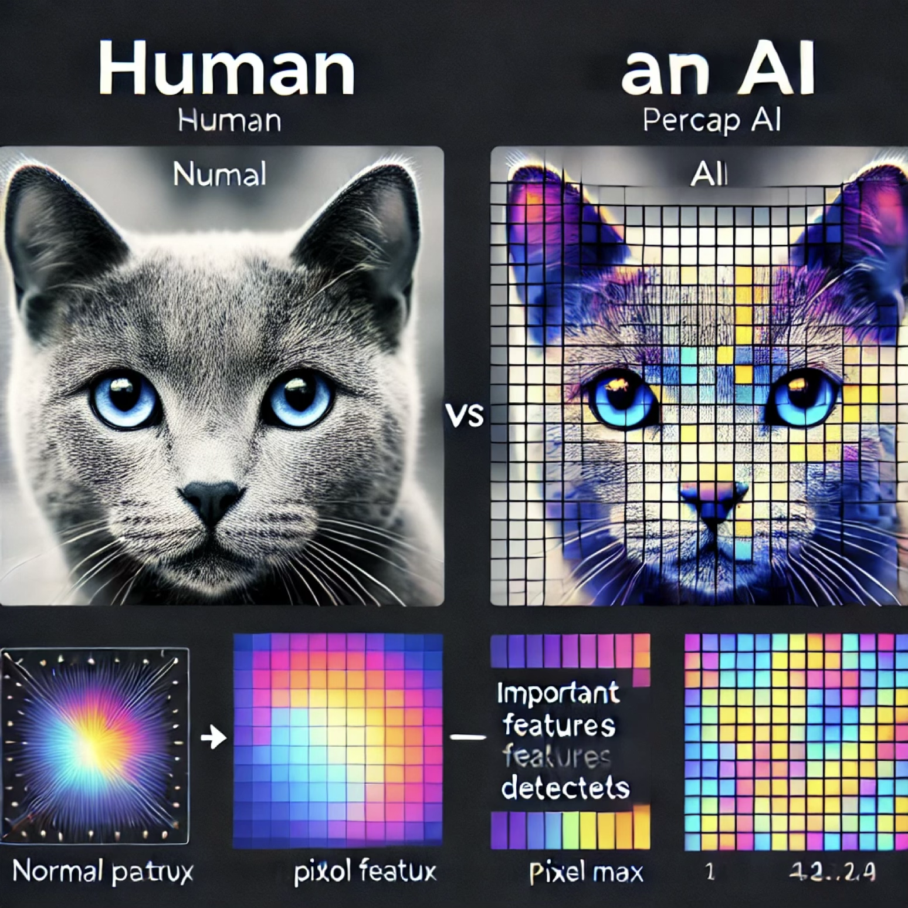
Images
AI systems don't "see" images, "hear" sounds, or "read" text the way humans do.
Instead, they convert everything into numbers (vectors, matrices, probability distributions).

Slide 24
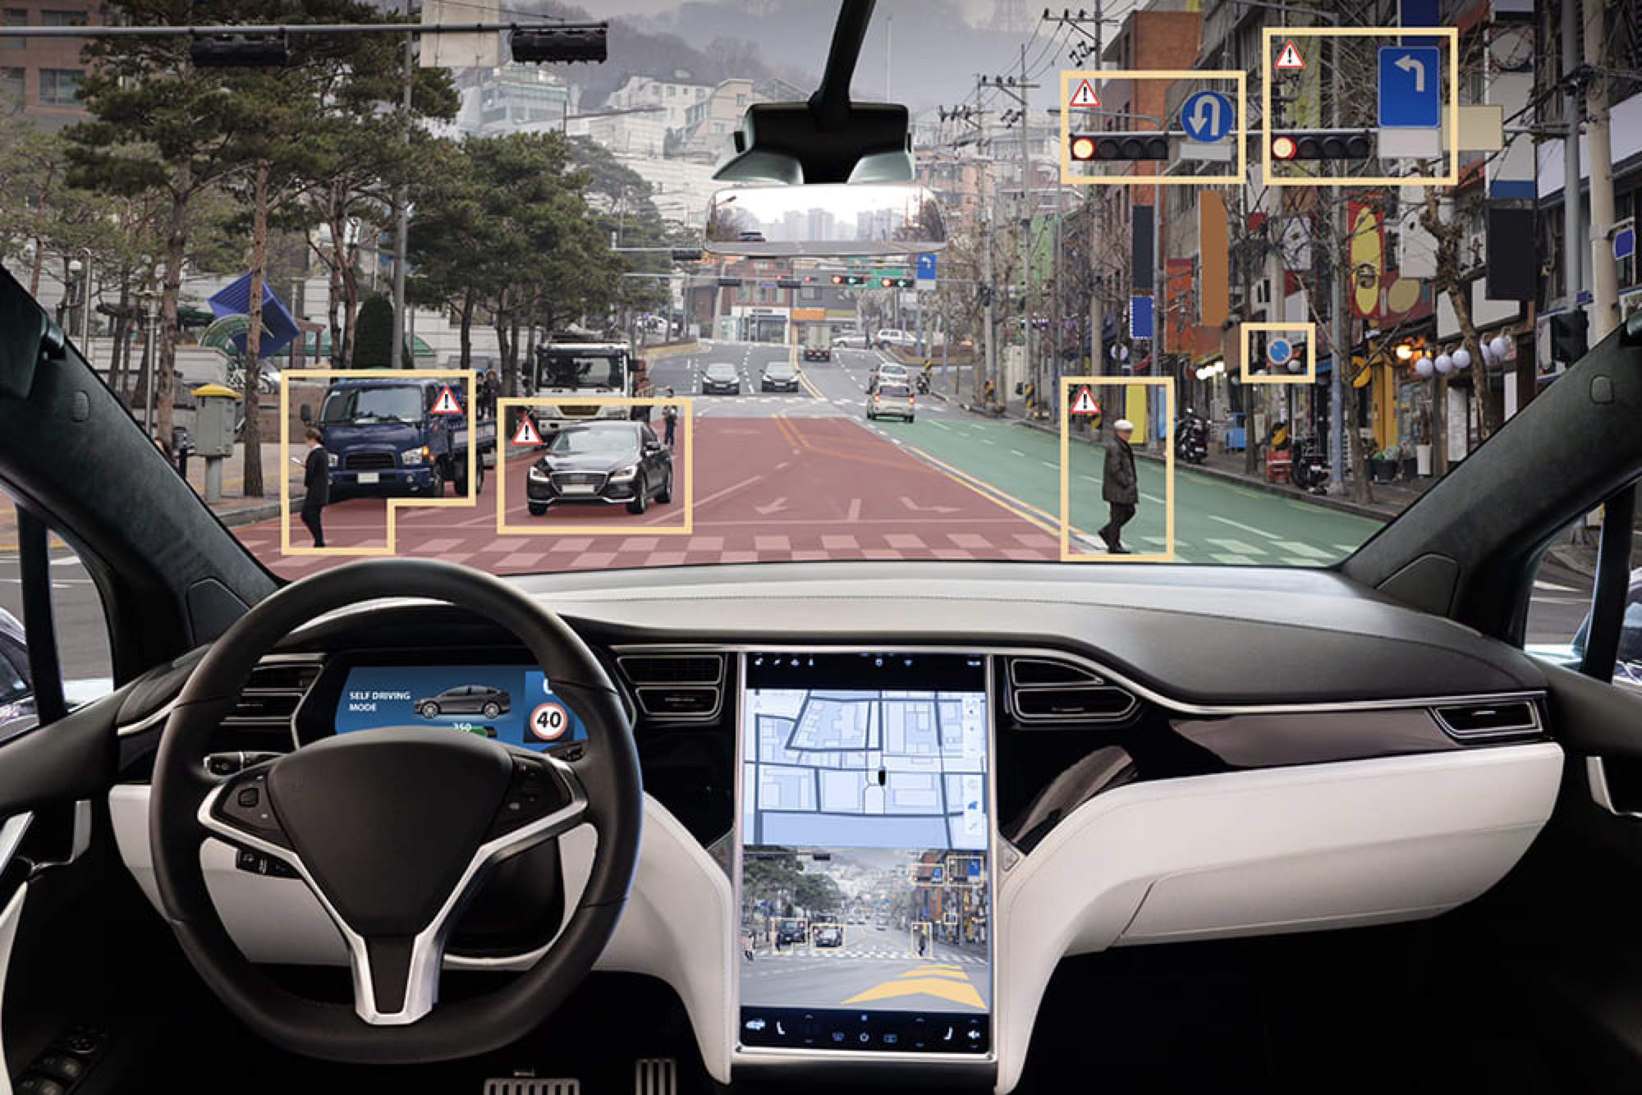
Why do we need to process them?
Imagine you have a self-driving car.
How does it recognize a stop sign?

Slide 25
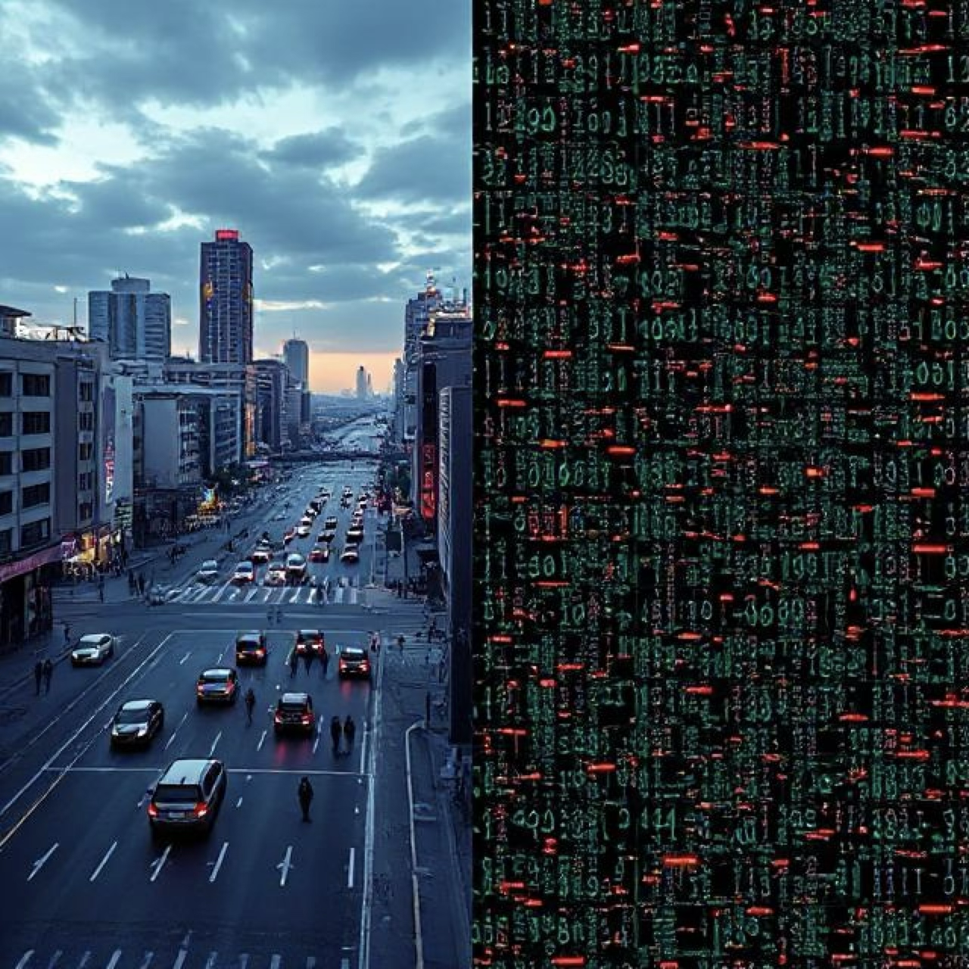
How?
The camera captures an image of the road.
The image is converted into a matrix of pixel values.
AI uses Linear Algebra (Matrix Transformations) to extract features.
It applies Probability & Optimization to classify the image.
Computer doesn’t "see" images—it processes numbers and patterns to make decisions!

Slide 26
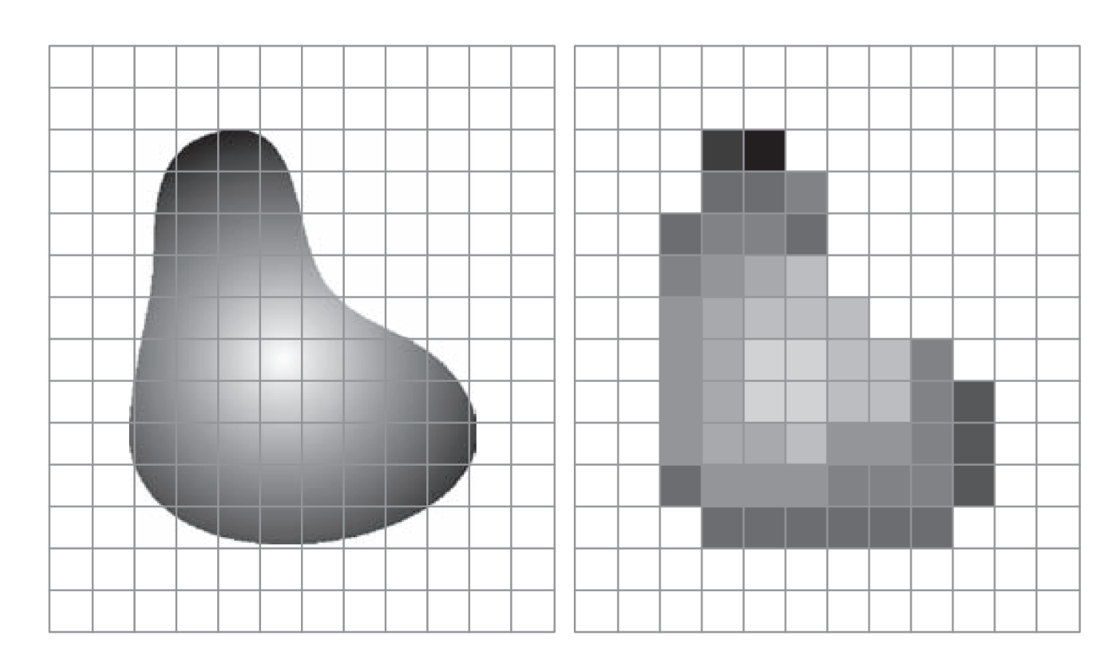
Acquired Image

Slide 27
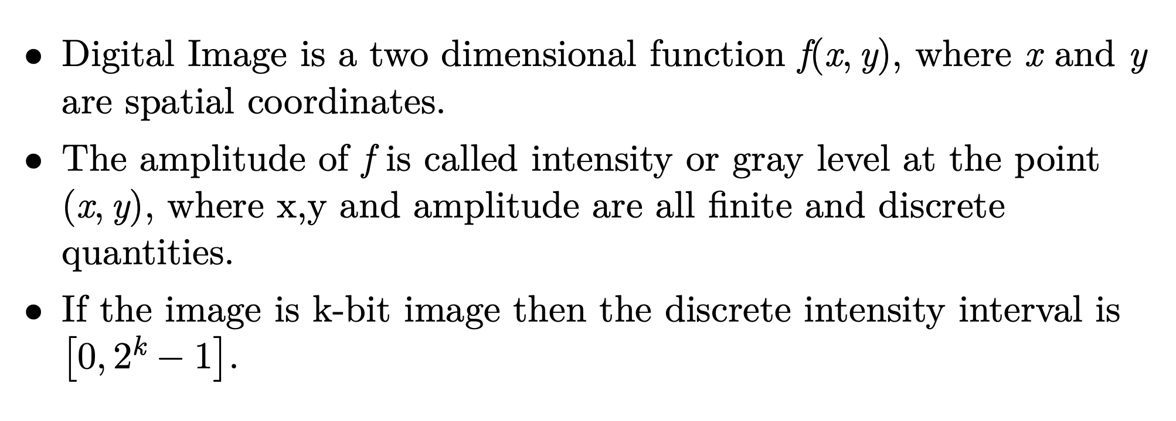
Digital Image

Slide 28
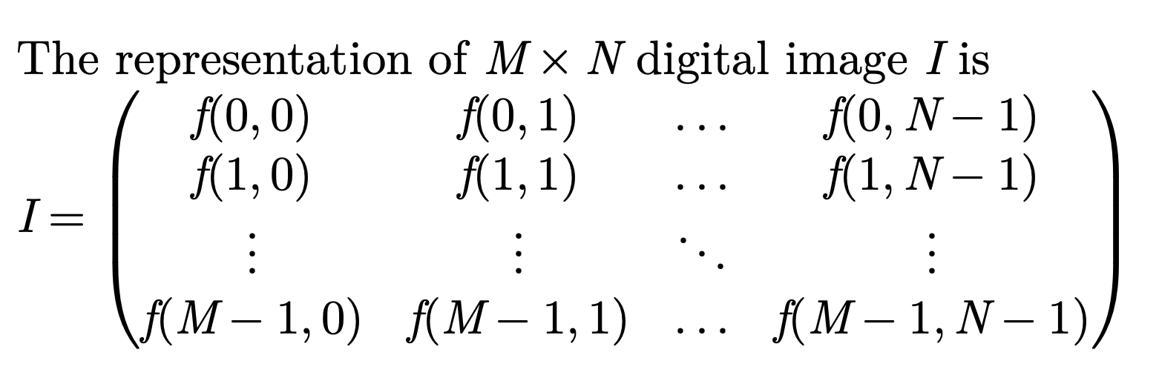

Slide 29
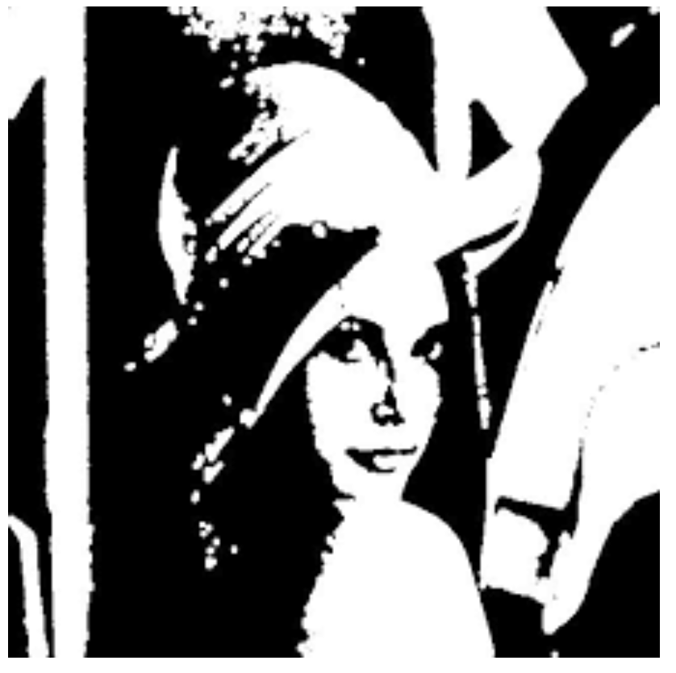
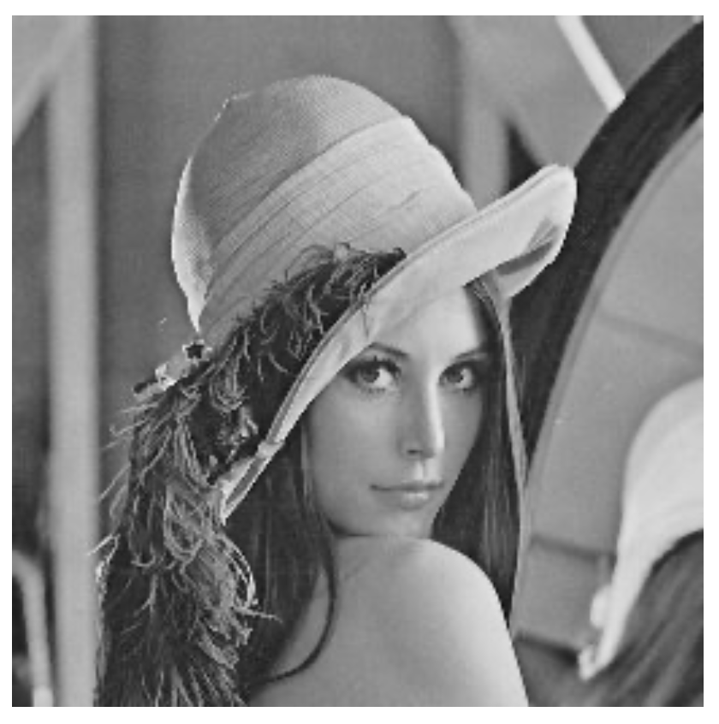
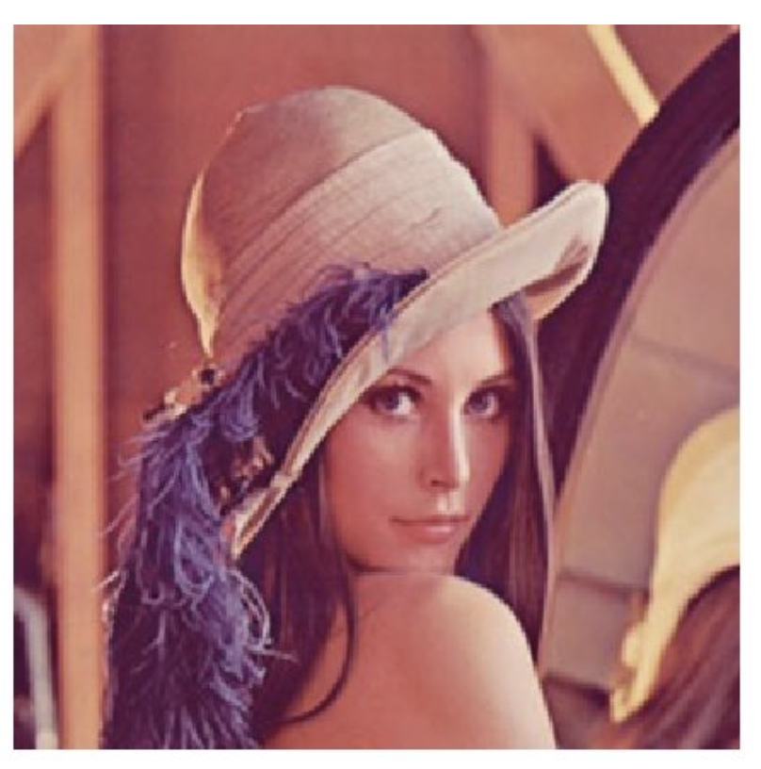
Types of Images
Gray Scale
Binary
Colour

Slide 30
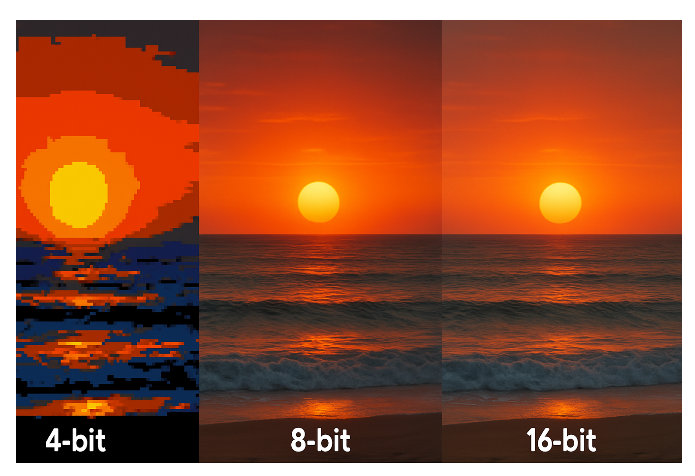
4-bit vs 8-bit vs 16-bit

Slide 31
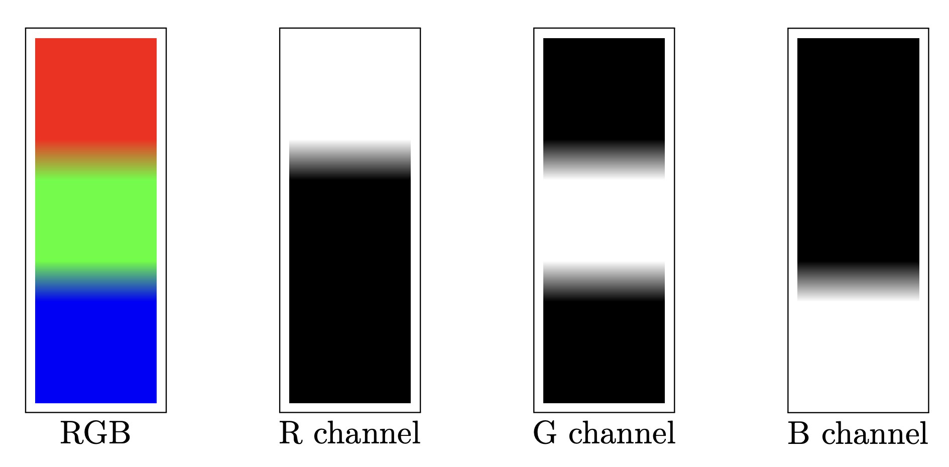

Slide 32
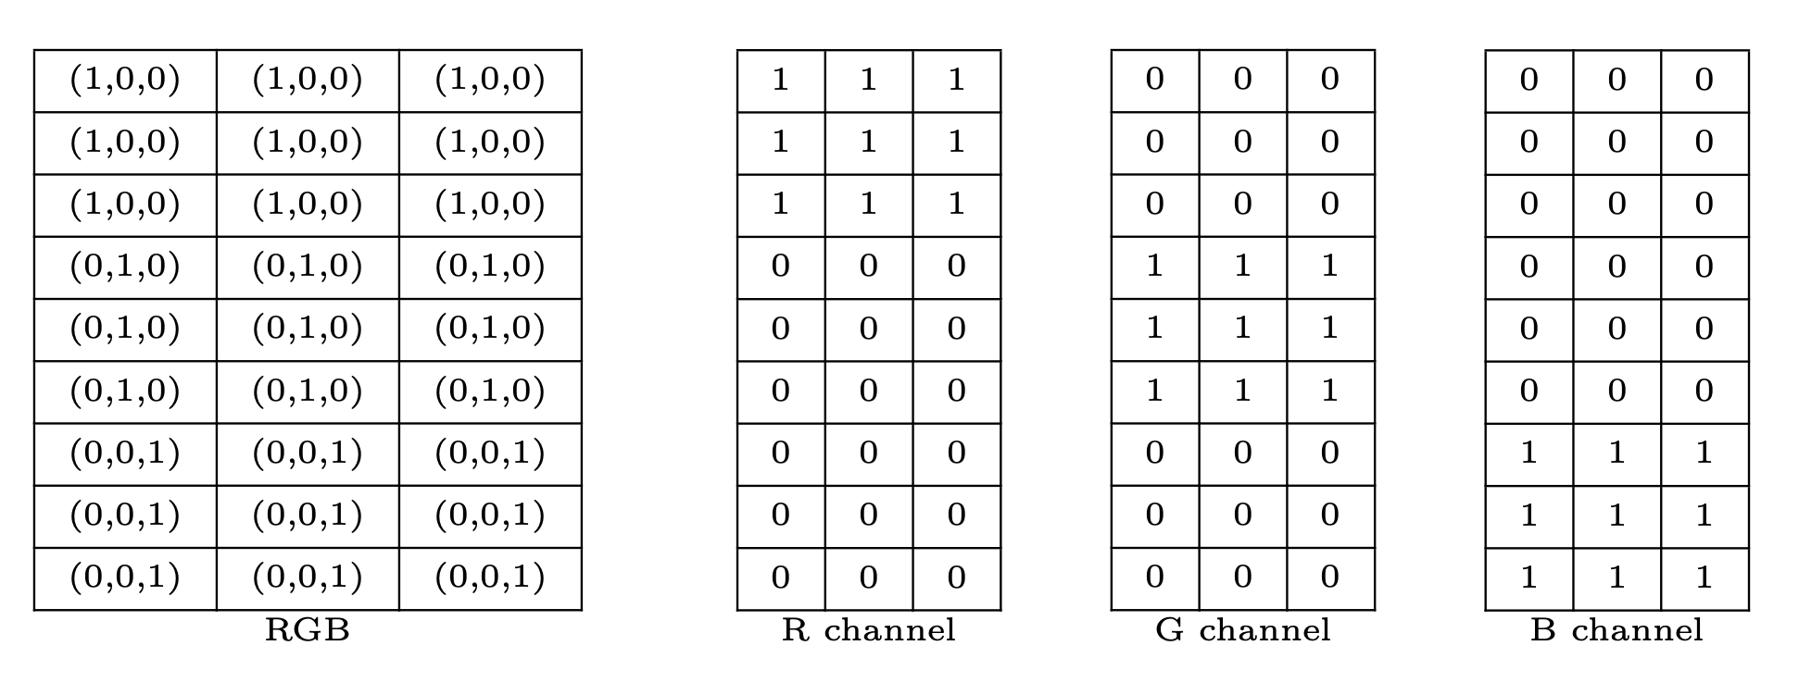
Entries

Slide 33
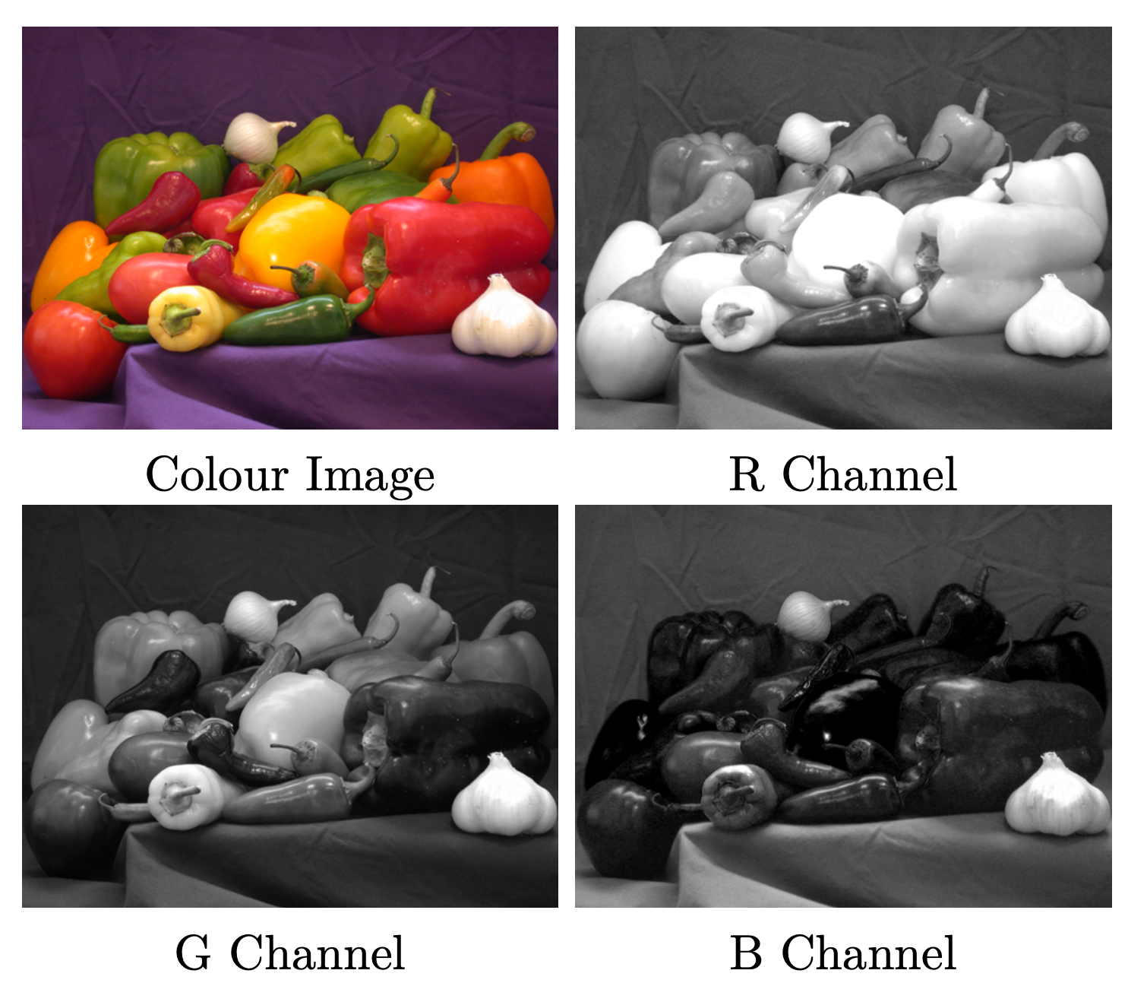

Slide 34
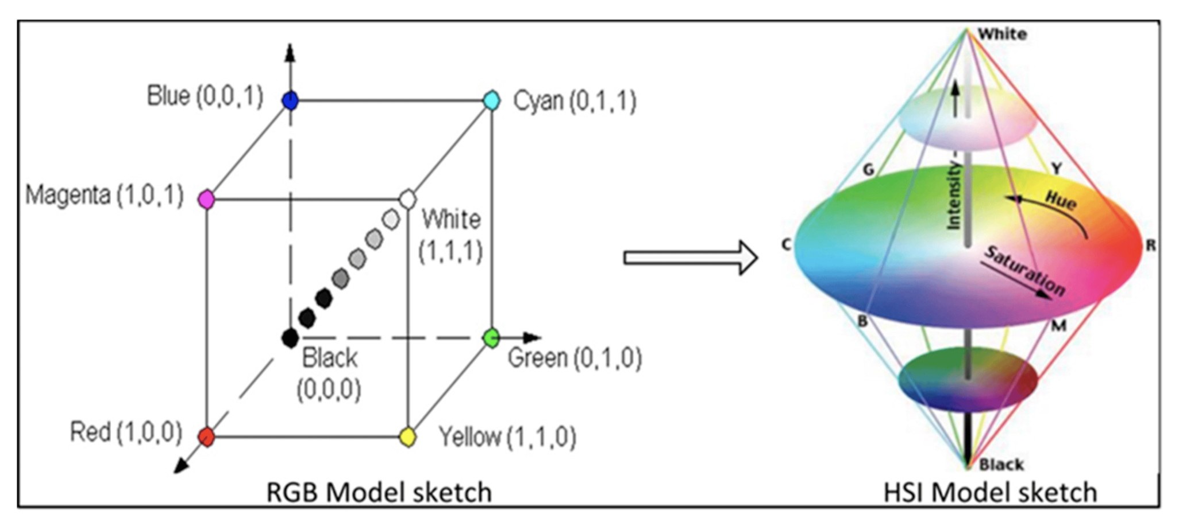
HIS Color Space

Slide 35
HSI
All the points contained in the plane segment defined by the the intensity axis and the boundaries of the cube have the same hue.
The HSI colour model decouples the intensity component from the colour carrying information in the image.
The HSI colour model is an ideal tool for developing image processing algorithms based on colour descriptions.

Slide 36
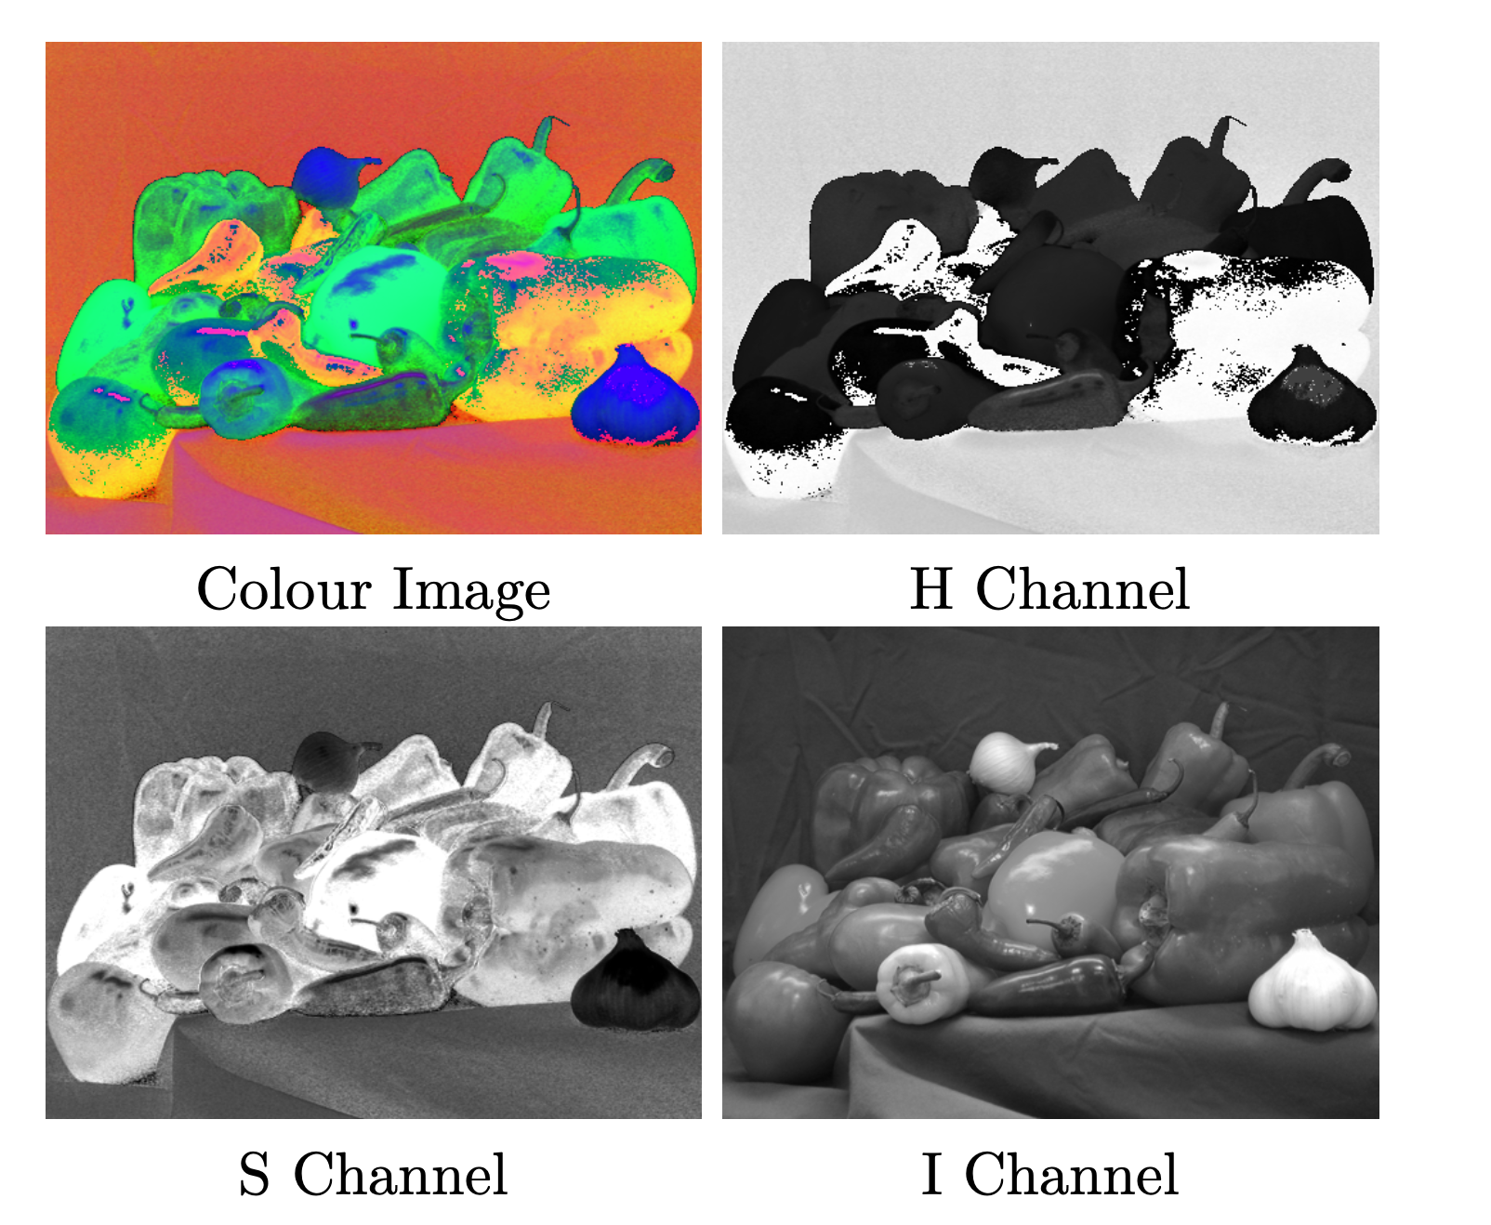

Slide 37
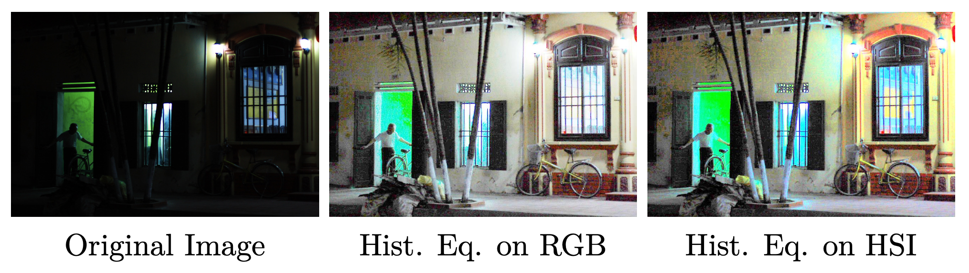

Slide 38
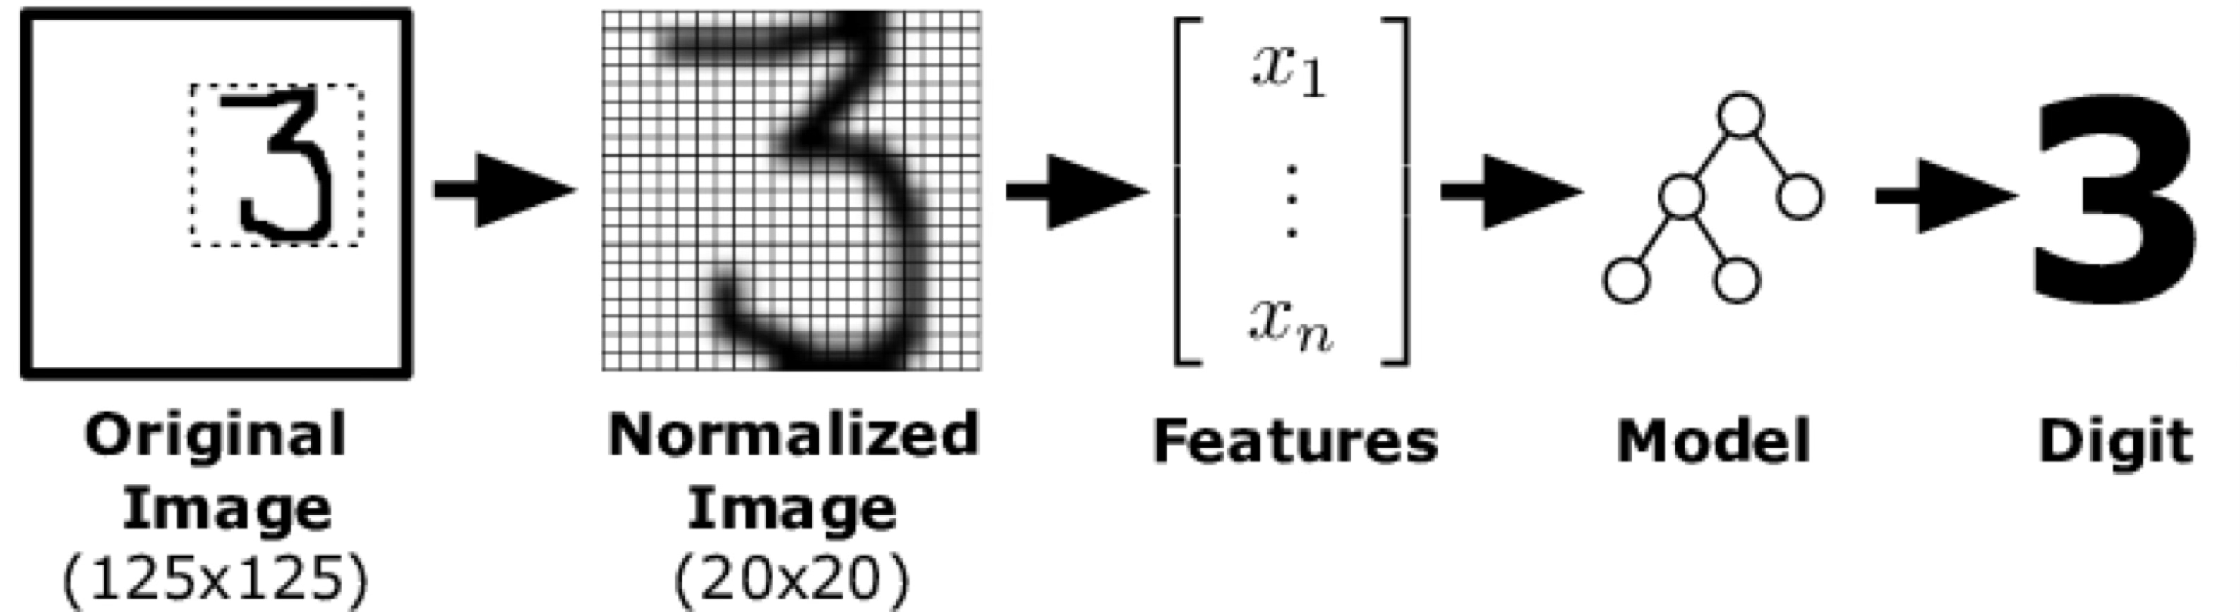
ML pipelines for Image Recognitions.

Slide 39
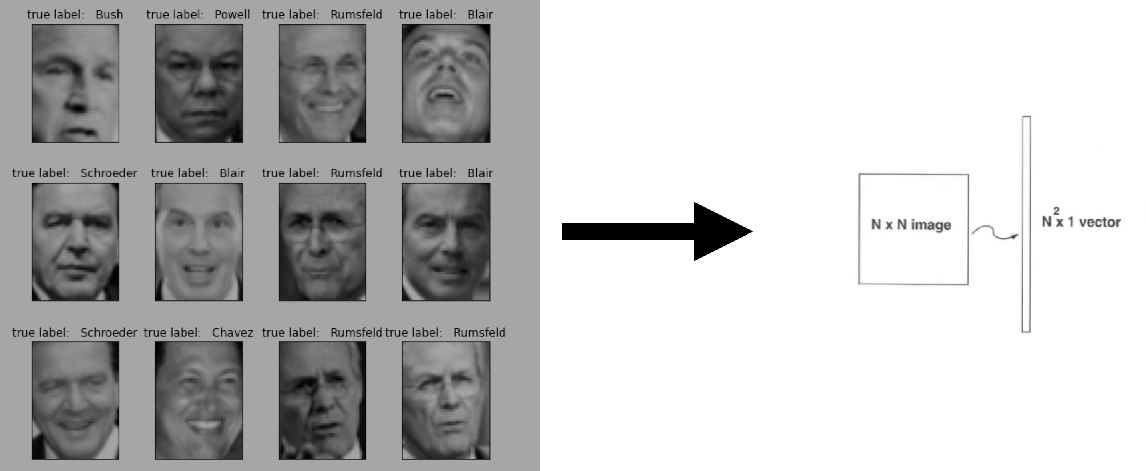
Example: Eigenfaces for Face Recognition

Slide 40
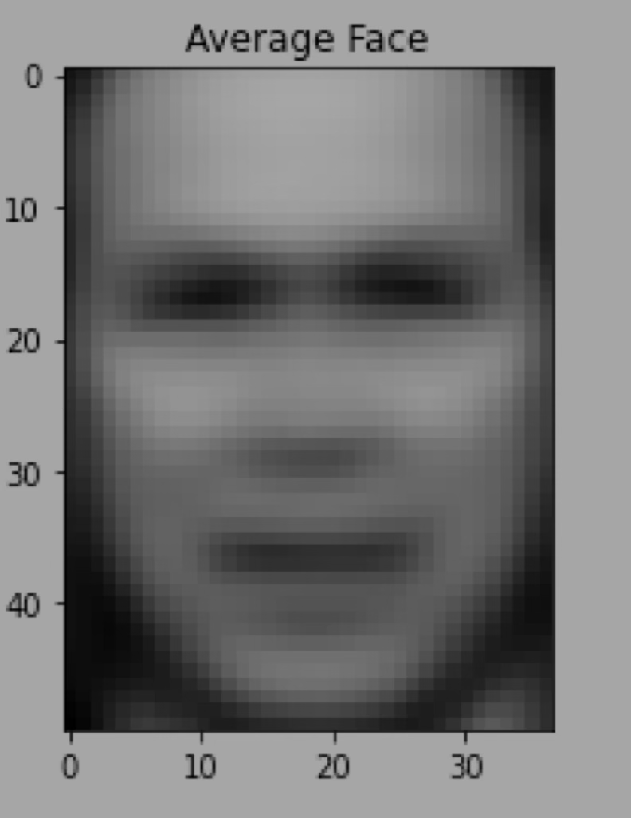
Compute the average face by taking the mean of all face images.
Subtract the mean face from each image to get the centered data matrix.

Slide 41
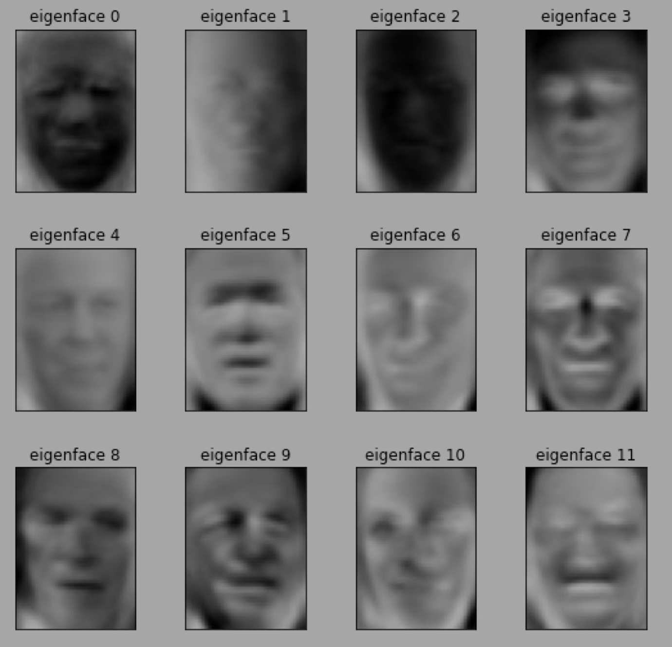
Compute the Covariance Matrix and Eigenvectors
Compute the eigenvalues and eigenvectors of this covariance matrix.
The eigenvectors (also called Eigenfaces) capture the main variations in the dataset.

Slide 42
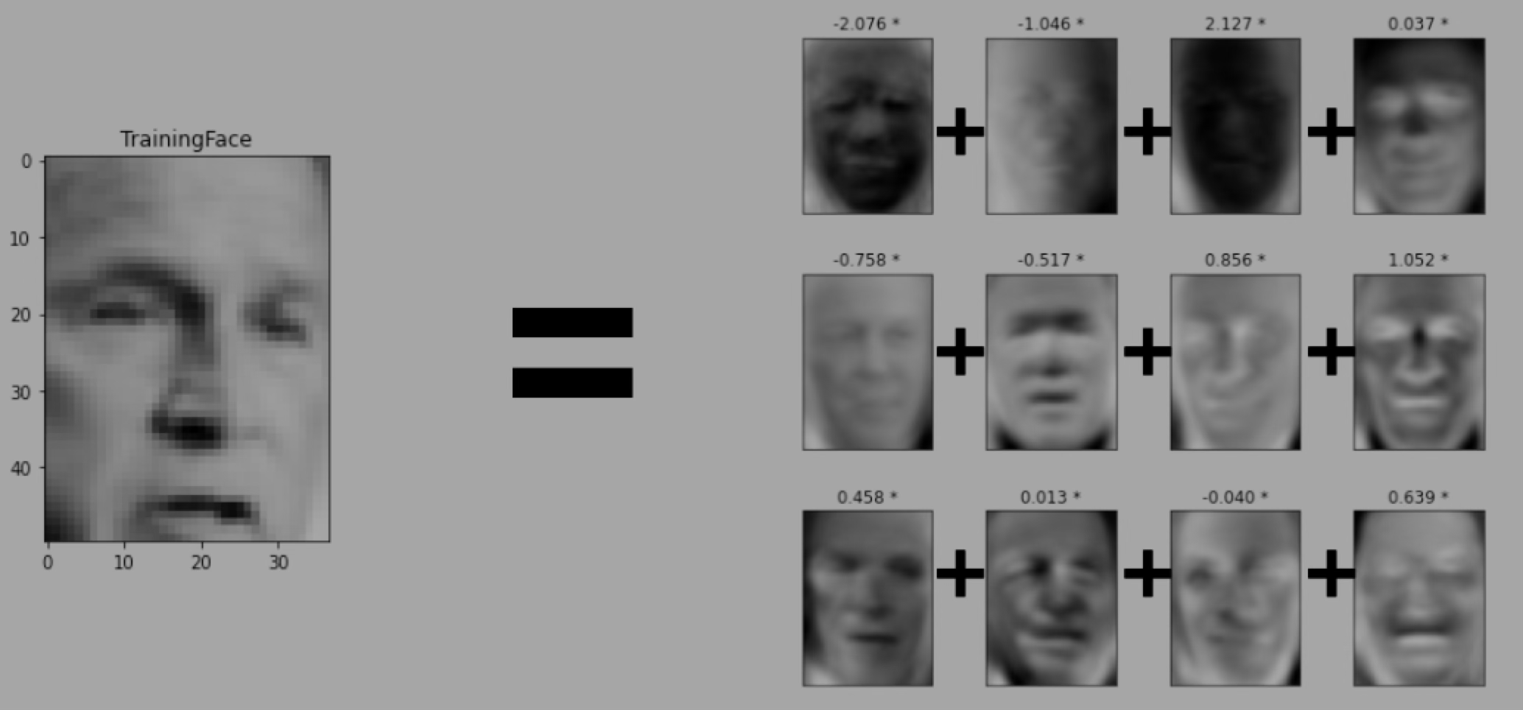
Each face can be represented as a weighted sum of eigenfaces.
Instead of storing 10,000 pixel values per image, we store just a few PCA coefficients.

Slide 43
Face Recognition Using PCA
To recognize a face, project a new input face onto the eigenface space.
Compare the PCA representation with stored representations using distance metrics (e.g., Euclidean distance).
The closest match identifies the person.

Slide 44
Advantages:
Easy to implement and computationally less expensive.
No knowledge (such as facial feature) of the image required (except id).
Limitations :
Proper centered face is required for training/testing.
The algorithm is sensitive to lightining, shadows and also scale of face in the image .
Front view of the face is required for this algorithm to work properly.

Slide 45
ML is just a giant optimization problem!

Slide 46
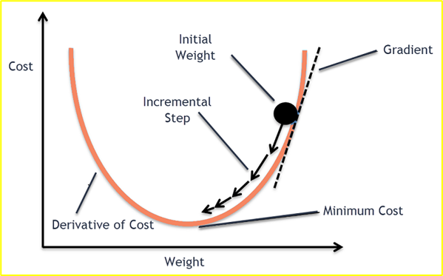
Optimization: How ML Learns Efficiently
How Gradient Descent minimizes loss?

Slide 48
References
R. Duda, P. Hart & D. Stork, Pattern Classification (2nd ed.), Wiley (Required)
T. Mitchell, Machine Learning, McGraw-Hill (Recommended)
Papers

